Slide 1

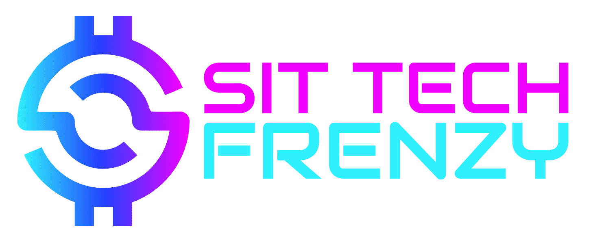
Siliguri Institute Of Technology
DUAL AXES SOLAR PANEL
Presented By:
Rick Sarkar [AIML/1st Year]
Aniruddha Das [ECE/1st Year]
Souvik Nag [ECE/1st Year]
Ayushman Dey [AIML/1st Year]
Paushali Karmakar [CSE/1st Year]
Taniskaa Saha [AIML/1st Year]

Slide 2

Acknowledgement
We would like to express my sincere gratitude to the organizers of this hackathon for providing us with the opportunity to collaborate, innovate, and learn. We are immensely thankful for the hard work and dedication put into making this event possible. We also want to extend our appreciation to our fellow participants for their enthusiasm and creative spirit. Together, we've made this hackathon a memorable and enriching experience. Special thanks to our seniors and judges for their invaluable guidance and feedback.

Slide 3
Problem statement
We know that the sun is always changing it’s position with respect to the Earth. But conventional solar panel are fixed at a particular angle. So their efficiency is reduced significantly in the terms of absorbing the sunlight.
To increase the efficiency of common solar panel by at least 30%, they can be made movable in either one axis or two axes to track the sun. In India there is already single axis solar tracker system exist. But till now dual axis solar tracker system is not there, So we have created a small model for that.

Slide 4
Materials use in this model
LDR (5-pics)
Solar panel (Mini)
Servo motor (2-pics)
Arduino UNO (ATmega328p)
Jumper wires
Normal wires
Power supply
Sun board for body
Programming skills

Slide 5
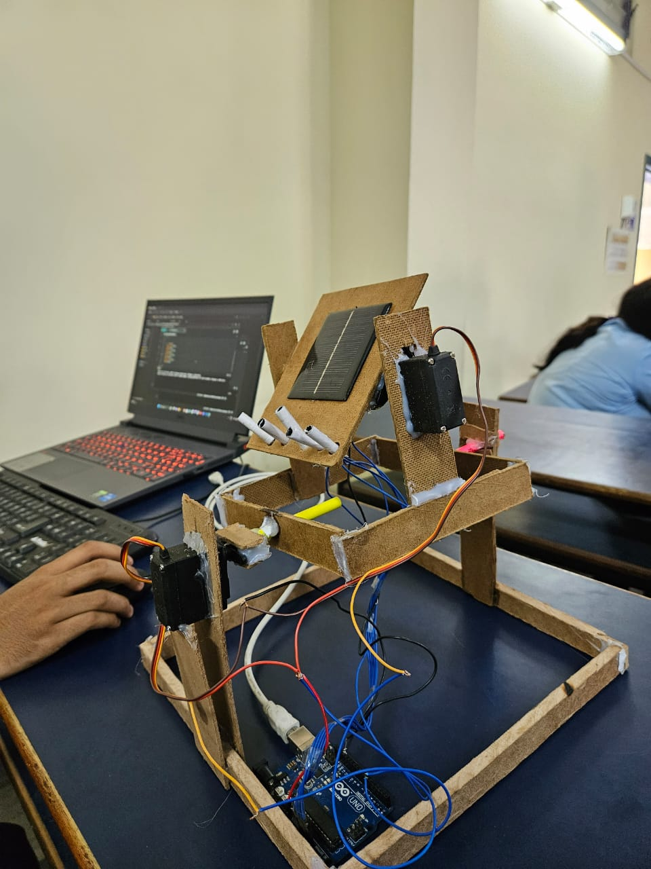
How it works?
This tracking system has the 2 axes, means 2-Dimentinal, that is set on two rotating axes to derive a proper angle that can help them get the maximum sunlight.
At first we are adjusting the surface of solar panel by rotating it around both the axes, it can be called “Dual Axis solar tracker”.
Then after every 20 minutes the same process will pe procced for re-positioning of solar panels.
Model

Slide 6
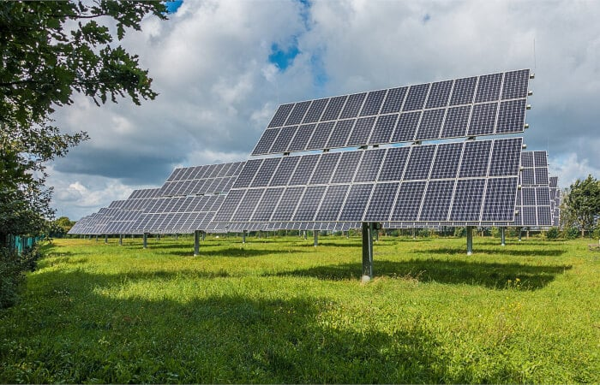
PROCESS
Solar Panel
LDR 1,LDR2…
Arduino
Servo Motor 1 + Servo Motor 2 Solar set

Slide 7
Advantages
Dual/double axis solar tracking system will track the sun from East to West as well as from North to South.
These tracking system is cheap and very simple to set up.
Double axes tracker suit companies that want a low cost option and value for money
They will also fit for all areas where the sun light intensity is very less
The effectiveness of double axes solar tracker over fixed solar tracking mount system is 32% approx.

Slide 8
Future improvement
Implement more advanced tracking algorithms for increased accuracy.
Integrate real-time clock (RTC) module for precise time-based tracking.
Incorporate wireless communication for remote monitoring and control.
Enhance the system to withstand adverse weather conditions.

Slide 9
Conclusion
The Dual Axis Solar Tracker project demonstrates how a system can automatically orient a solar panel to maximize its exposure to sunlight. This enhances the panel's energy production and overall efficiency, making it a valuable addition to solar energy systems.
Reference
Arduino.cc
Servo library
Online documentations

Slide 10
Thank You

